Slide 1
Large-Scale and Multi-Structured Databases Project Design JustRecipe
Francesco Campilongo
Daniele Cioffo
Francesco Iemma

Slide 2

Application Highlights
The JustRecipe application is designed to create a community of cuisine lovers.
The main features of the application are:
Users can browse and add recipes
User can modify his own recipes
Social Network features
Follow a user
Like a recipe
Comment a recipe
Obtain suggestions

Slide 3
Actors and main supported functionalities
Unregistered User
Sign-up
User
Login/Logout
Search a recipe
Browse suggested recipes
Browse recipes of following users
Add a recipe
Edit own recipes
Comment recipes
Follow another user
Like a recipe
Moderator
Delete comments
Administrator
Delete users
Delete recipes
Elect moderators

Slide 4
Dataset Description
Source:
https://eightportions.com/datasets/Recipes/
https://www.kaggle.com/hugodarwood/epirecipes?select=full_format_recipes.json
Description:
Datasets containing recipes. Each one of them is in JSON format.
Volume:
45349 recipes (67.8 MB)
Variety:
We use two datasets of recipes, obtained by scraping Foodnetwork.com and Epicurios.com. Both datasets have been cleaned up by removing duplicates.
Velocity/Variability:
Variability and Velocity are ensured by deleting and/or adding recipes and comments

Slide 5
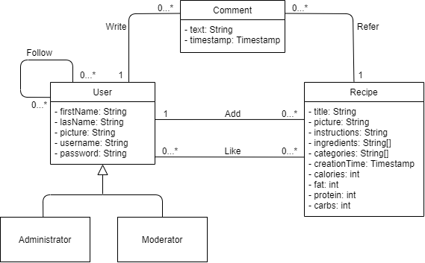
Preliminary UML Class Diagram

Slide 6
Requirements and Entities handled by Document DB
Collections:
Recipe
High Level Query:
Search a recipe given certain parameters (recipe’s name, recipe’s ingredients)
Low caloric recipes, low fat recipes, low carbs recipes, high protein recipes
Search the most common recipe categories
Last written comments (for moderator)
Categories under/over a caloric/carbs/fat/protein average
Show the daily sum of recipe calories added by a user in the last week. A plot will show the weekly trend
Last written recipes of the following users
Fastest recipes

Slide 7
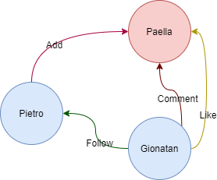
Requirements and Entities handled by Graph DB
Entities:
Recipe
User
Relations:
User – Recipe: Like
User – User: Follow
User – Recipe: Comment
User – Recipe: Add
High Level Query:
Suggested recipes (considering hops number)
Best recipes (considering likes)
Most followed and active user (centrality measure)
Top Commentators
Most liked user (considering his/her recipes)

Slide 8
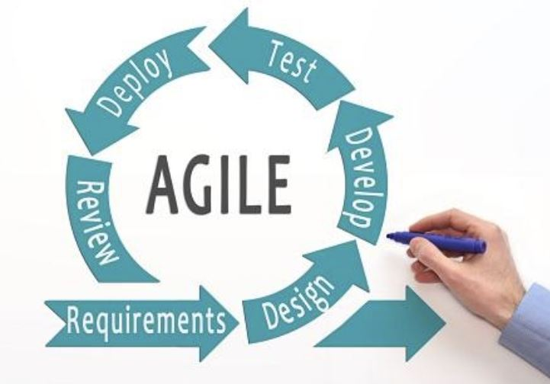
Software Architecture Preliminary Idea
Programming Language:
JavaFX
DBMSs:
MongoDB
Neo4J
Frameworks:
JUnit
Log4J
Maven

